Slide 1
Asking Questions the Human Way: Scalable Question-Answer Generation from Text Corpus
Advisor : Jia-Ling, Koh
Speaker : Hsiao-Ting Huang
Source : www’20
Date : 2022/03/08

Slide 2
Outline
Introduction
Method
Experiment
Conclusion

Slide 3
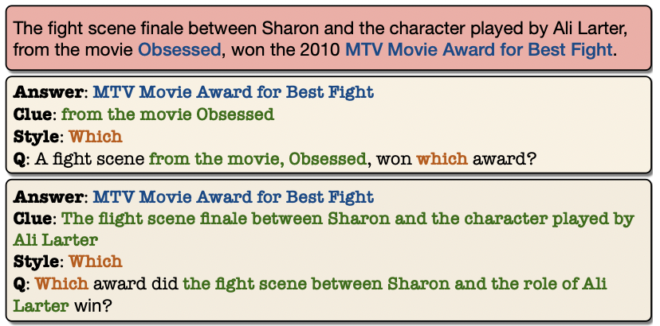
answer-aware Question Generation
Input
Passage
Answer
Question
output
one-to-many mapping

Slide 4
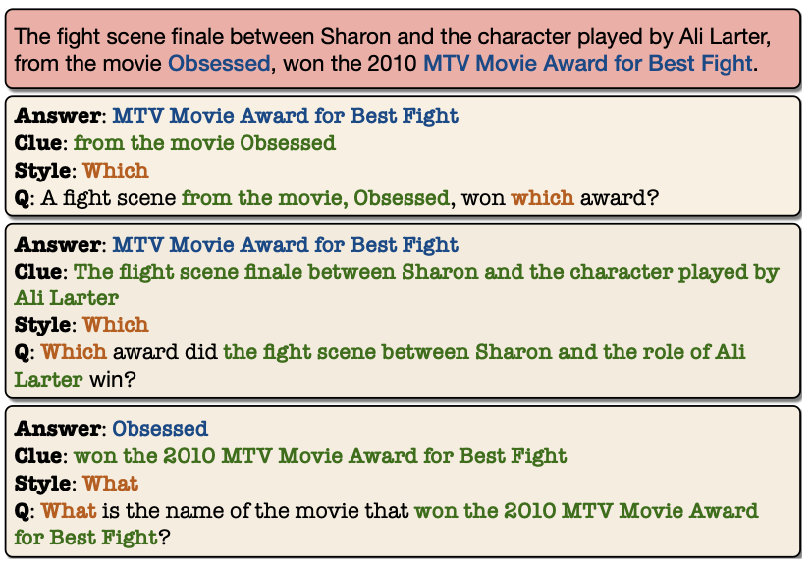
ACS Question Generation
input : Passage
Answer
Clue
Style
output : Question

Slide 5
framework
1.
4.
2.
3.

Slide 6
Method : 1.Obtaining Training Data
SQuAD : reading comprehention dataset , contain <p , q , a> tuples
p
q
a
our problem : input and output consists of <p , q , a , c , s >

Slide 7
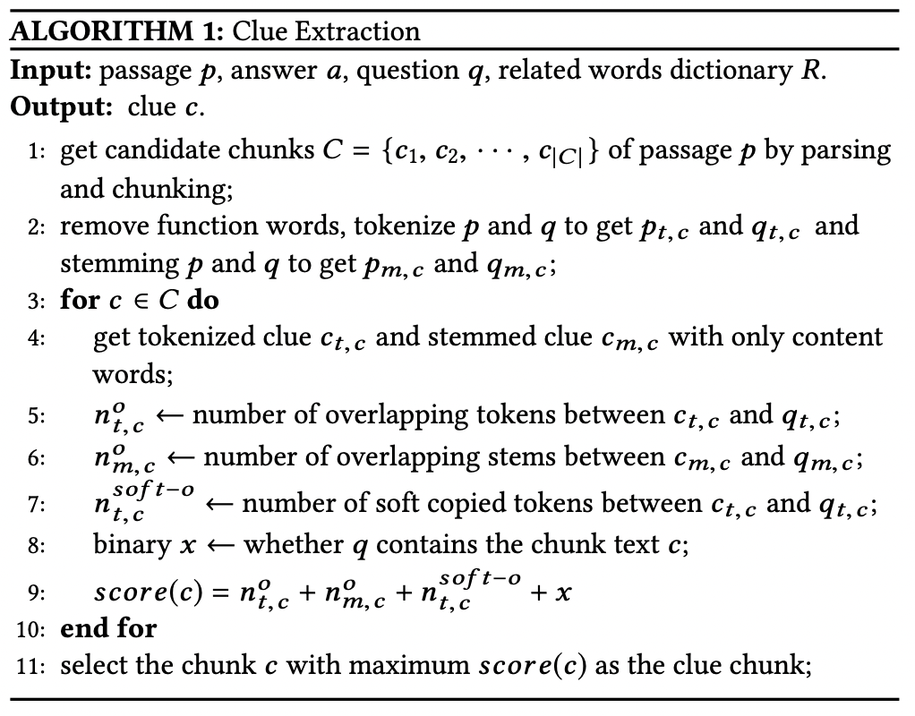
Clue Identification
Passage:
The fight scene finale between Sharon and the character played by Ali Larter, from the movie Obsessed, won the 2010 MTV Movie Award for Best Fight.
c₁
c₃
c₂
Question:
A fight scene from the movie, Obsessed, won which award?

Slide 8
Clue Identification
Passage:
The fight scene finale between Sharon and the character played by Ali Larter, from the movie Obsessed, won the 2010 MTV Movie Award for Best Fight.
Q: A fight scene from the movie, Obsessed, won which award?
tokenize : {fight,scene,movie…}
stem : obessed -> obess , won -> win
p_{t,c} q_{t,c} c_{t,c}
p_{m,c} q_{m,c} c_{m,c}

Slide 9
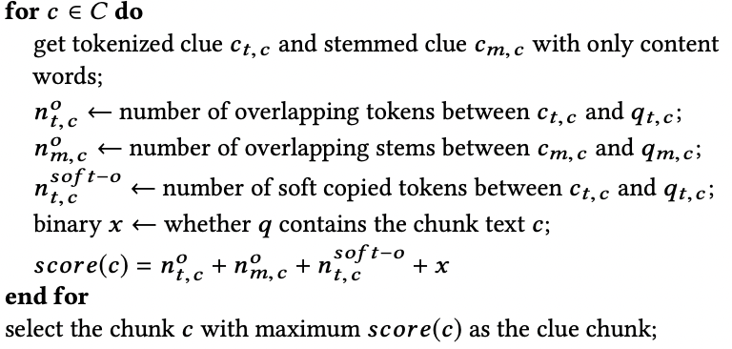
Clue Identification
soft-copy
C : Selina left her hometown at the age of 18”
Q : How old was Selina when she left?

Slide 10
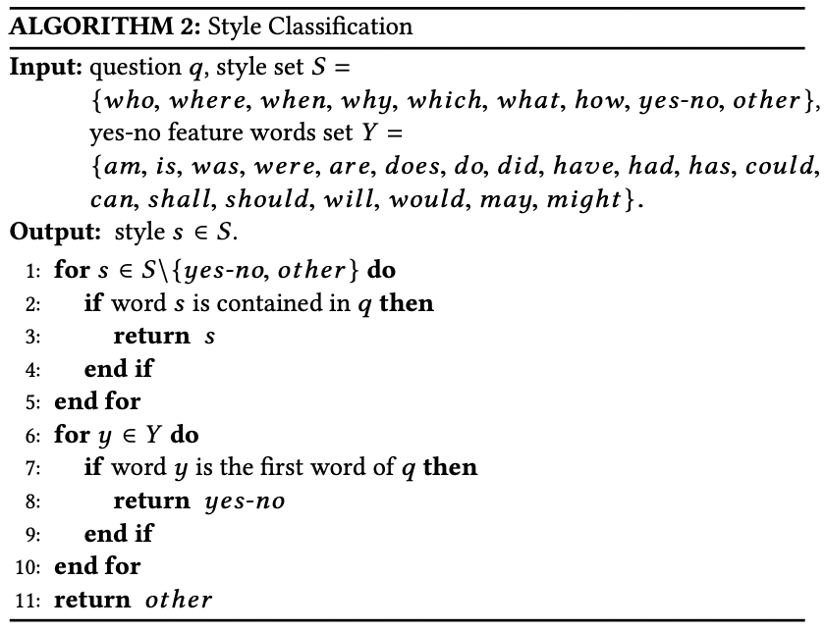
Style Identification
classify a given question into 9 classes

Slide 11
ACS-Aware Question Generation
model 1 : Seq2Seq-based
model 2 : GPT2-based

Slide 12
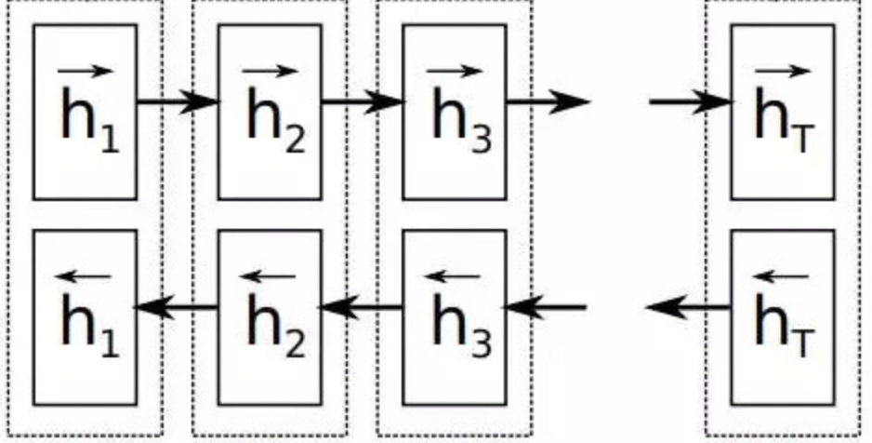
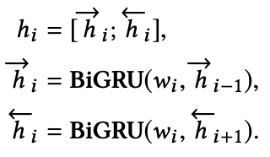
Seq2Seq-based :
Encoder
word vector
NER tag embedding
POS tag embedding
content word
position of a and c
Ecoder : Bi-GRU
300
16
16
embedding layer
16
16
dimension
{ p₁ , p₂ , p₃ , … p_{i} }
each word p_{i} in input P

Slide 13
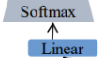
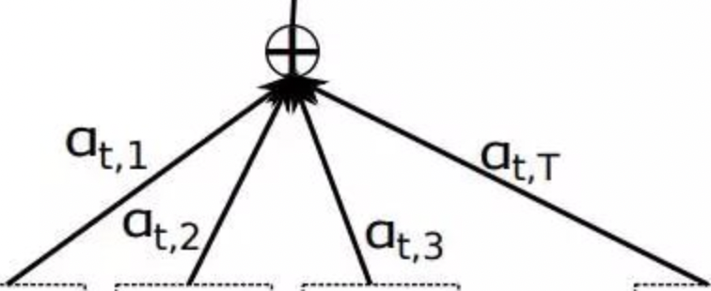
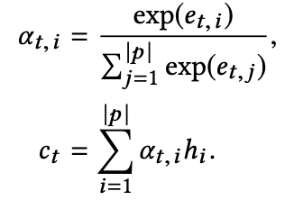
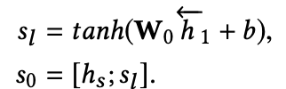
Seq2Seq-based :
Decoder
X
X
Vocabulary distribution
Attention distribution

Slide 14
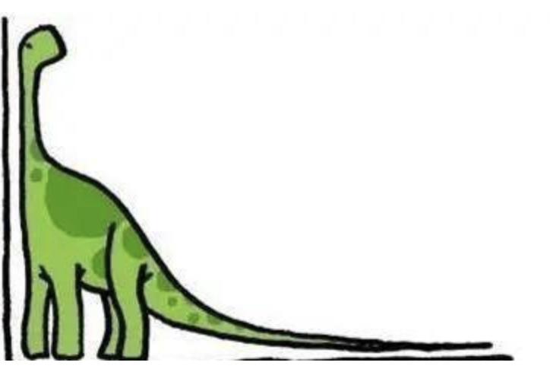
Seq2Seq-based : Vocabulary Reduction
reduce the vocabulary size to be the
top N_{V} high-frequency words
frequency
Low frequency
vocabulary
top N_{V}

Slide 15
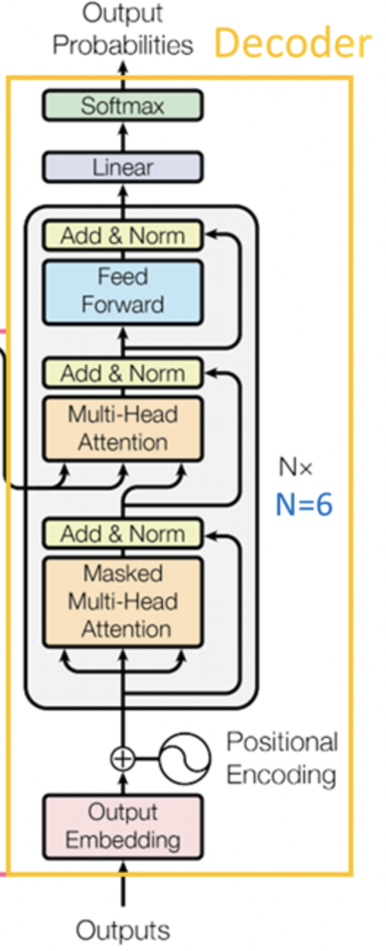
GPT2-based
GPT2-small model :
fine-tuning
X 12
Training input

Slide 16
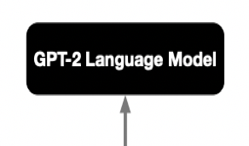
GPT2-based
1.
0.95
0.05
2.
0.25
0.43
0.27
0.05
Generating
3.
0.1
0.05
0.12
0.05
0.1
…
Question
Sample:
using top-p nucleus sampling
with p = 0.9 , instead of
Beam search and top-k sampling
Generating input

Slide 17
3.Sampling inputs
extract valid inputs < passage , answer , clue , style >
steps :
answer
style
clue

Slide 18
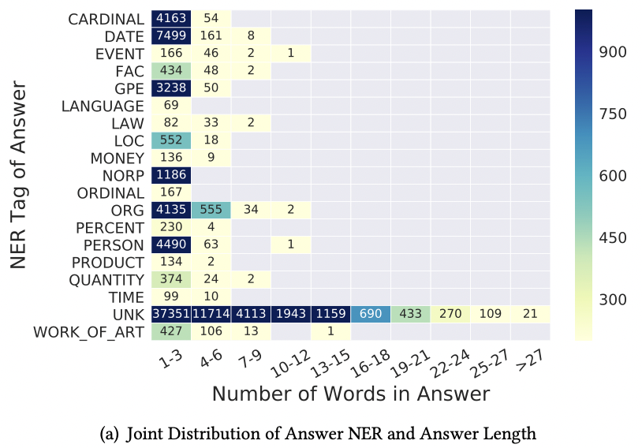
Sampling inputs
most of the answers are short
person(PERSON)
organization (ORG)
date (DATE)

Slide 19
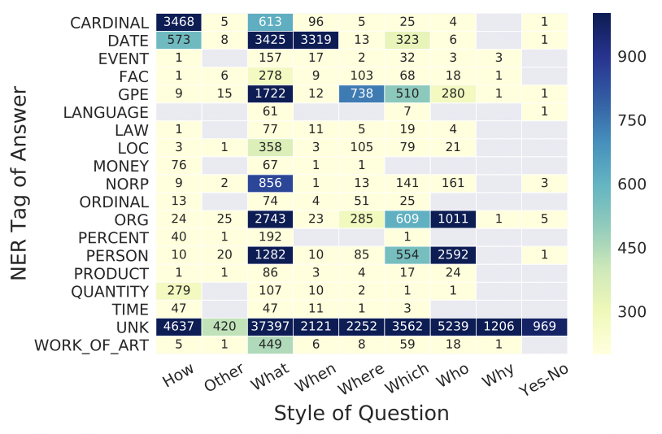
Sampling inputs
The NER tags of answers are highly correlated with the style of questions

Slide 20
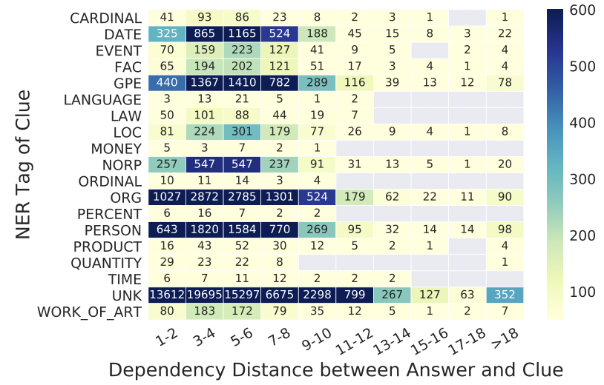
Sampling inputs
DepDist(c,a) is usually less than 8

Slide 21
Sampling inputs
candidate chunks K = {k₁,k₂,··· ,k_{|K|}} over passage, sample k_{i} as answer :
possible questions styles S = {s₁, s₂, · · · , s _{|S |} }, sample s_{i} as style:
sample a chunk k_{l} as clue:
5 answer, 2 style, 2clue, sampling 20 questions for each sentence

Slide 22
Data Filtering
BERT-based entailment model :
<q,a> pair matches with the content in the input passage
BERT-based QA model :
the F1 similarity score of gold answer span and predicted answer span is above 0.9

Slide 23
Experiment-Dataset
SQuAD : reading comprehention dataset , contain <p , q , a> tuples
 | training set | validation set
SQuAD | 86635 | 17929
 | passage | question | answer
average lengths | 32.72 | 11.31 | 3.19

Slide 24
Experiment-metrics
Rouge-L
BLEU
prediction1 : police kill the gunman
prediction : the cat sat on the mat
prediction2 : the gunman kill police
reference : the cat is on the mat
prediction3 : thegunman police killed
BLEU-2 :
reference : police killed the gunman
{the cat ,cat sat ,sat on ,on the ,the mat }

Slide 25
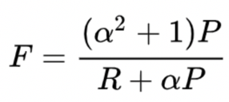
Experiment-metrics
Meteor
reference : A B C D
Predict : B A C D

Slide 26
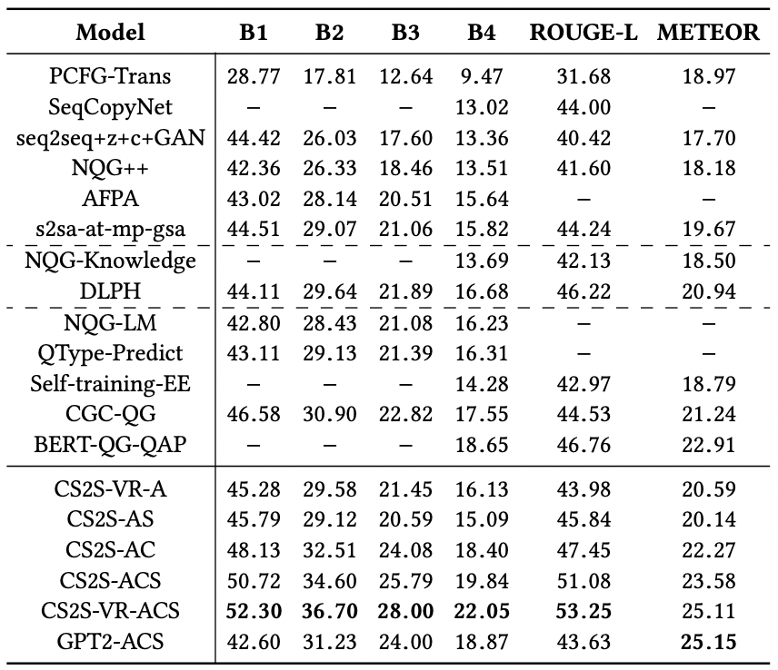
Experiment
our models

Slide 27
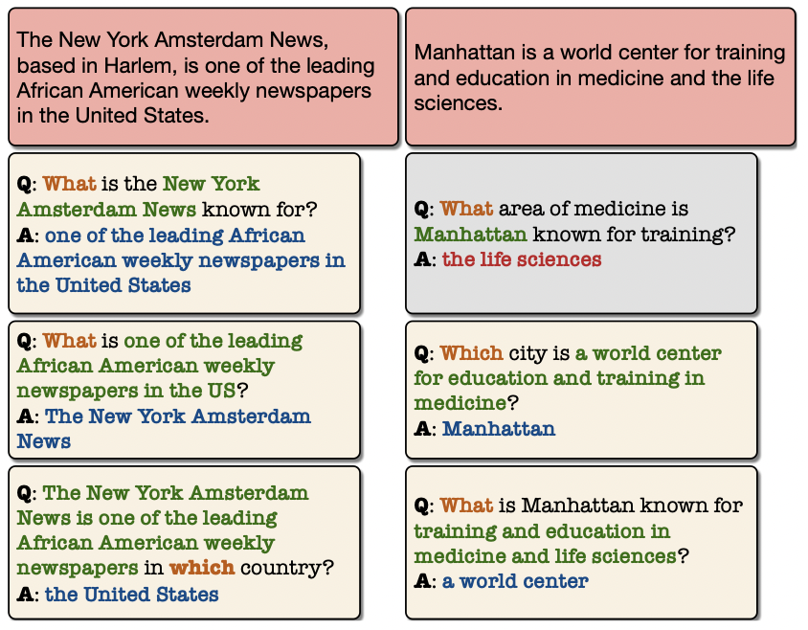
Experiment-Qualitative Analysis
Examples of the questions-answer pairs generated by our system

Slide 28
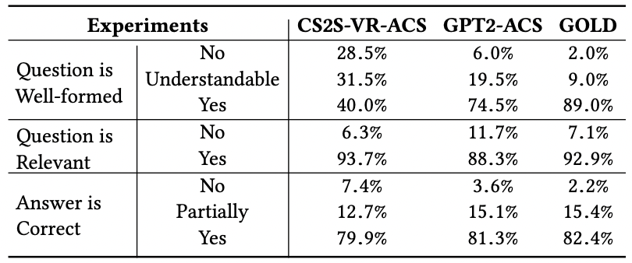
Experiment-Qualitative Analysis
71.5%
94%

Slide 29
Conclusion
we propose ACS-aware question generation to generate question-answer pairs from unlabelled text corpus in a scalable way
we have effectively converted the originally one-to-many question generation problem into a one-to-one mapping problem
our model is able to generate diverse and high-quality questions even from the same input sentence

